Slide 1
Algorithms Algorithm Analysis
CSE 464/574
Spring 2019

Slide 2
Binary search
public static int binarySearch( int[] a, int key) {
int low = 0;
int high = a.length-1;
while (key < a[mid]) {
int mid = low + (high – low) / 2;
if (key < a[mid] ) high = mid -1;
else if (key > a[mid] ) low = mid + 1;
else return mid;
}
return -1;
}
Invariant. If key appears in the array a[], then a[low] ≤ key ≤ a[high].

Slide 3
Binary search Analysis
Proposition. Binary search uses at most 1 + lg N key compares to search in a sorted array of size N.
Cost function:
We define T (N) = # key compares to binary search a sorted subarray of size ≤ N.
Binary search recurrence. T (N) ≤ T (N / 2) + 1 for N > 1, with T (1) = 1.

Slide 4
Proof sketch
Let’s assume that n is a power of 2
T(n) <= T(n/2) + 1
<= T(n/4) + 1 + 1
<= T(n/8) + 1 + 1 + 1
<= T(n/16) + 1 + 1 + 1 + 1
…
<= T(n/n) + 1 + 1 + 1 + … + 1

Slide 5
T(n) <= T(n/n) + 1 + 1 + 1 + … + 1
What is T(1) ?
T(1) = 1
How many 1s in the sum?
lg n
Thus: T(n) <= 1 + lg n
Worst case: T(n) is ~ lg n
T(n) = T(n/2) + 1 is called a recurrence relation

Slide 6
An N² log N algorithm for 3-Sum
Algorithm.
Step 1: Sort the N (distinct) numbers.
Step 2: For each pair of numbers a[i] and a[j],
binary search for -(a[i] + a[j]).
Analysis. Order of growth is N ² log N.
Step 1: N ² with insertion sort. [Of course, we could use a better search]
Step 2: N ² log N with binary searches.
Remark. Can achieve N ² by modifying binary search step.

Slide 7
An N² log N algorithm for 3-Sum
Hypothesis. The sorting-based N ² log N algorithm for 3-Sum is significantly faster in practice than the brute-force N ³ algorithm.
N | Time (seconds)
1,000 | 0.1
2,000 | 0.8
4,000 | 6.4
8,000 | 51.1
N | Time (seconds)
1,000 | 0.14
2,000 | 0.18
4,000 | 0.34
8,000 | 0.96
16,000 | 3.67
32,000 | 14.88
64,000 | 59.16
ThreeSum.java
Guiding principle. Typically, better order of growth
⇒ faster in practice.
ThreeSumFast.java

Slide 8
Types of analyses
Best case. Lower bound on cost.
・Determined by “easiest” input.
・Provides a goal for all inputs.
Worst case. Upper bound on cost.
・Determined by “most difficult” input.
・Provides a guarantee for all inputs.
Average case. Expected cost for random input.
・Need a model for “random” input.
・Provides a way to predict performance.

Slide 9
Examples
Example 1. Array accesses for brute-force 3-Sum.
Best: ~ ½ N ³
Average: ~ ½ N ³
Worst: ~ ½ N ³
Example 2. Compares for binary search.
Best: ~ 1
Average: ~ lg N
Worst: ~ lg N

Slide 10
Types of analyses
Best case. Lower bound on cost.
Worst case. Upper bound on cost.
Average case. “Expected” cost.
Actual data might not match input model?
Need to understand input to effectively process it.
Approach 1: design for the worst case.
Approach 2: randomize, depend on probabilistic guarantee.

Slide 11
Theory of algorithms
Goals.
Establish “difficulty” of a problem.
Develop “optimal” algorithms.
Approach.
Suppress details in analysis: analyze “to within a constant factor.”
Eliminate variability in input model: focus on the worst case.
Upper bound. Performance guarantee of algorithm for any input.
Lower bound. Proof that no algorithm can do better.
Optimal algorithm. Lower bound = upper bound (to within a constant factor).

Slide 12
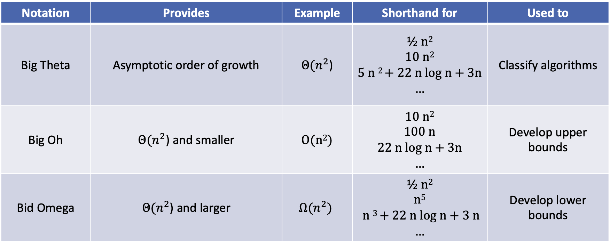
Notation | Provides | Example | Shorthand for | Used to
Big Theta | Asymptotic order of growth | $Θ(n^{2}$) | ½ n² 10 n² 5 n ² + 22 n log n + 3n … | Classify algorithms
Big Oh | $Θ(n^{2}$) and smaller | O(n²) | 10 n² 100 n 22 n log n + 3n … | Develop upper bounds
Bid Omega | $Θ(n^{2}$) and larger | $$Ω(n^{2})$$ | ½ n² n⁵ n ³ + 22 n log n + 3 n … | Develop lower bounds

Slide 13
Theory of algorithms: Example
Goals.
Establish “difficulty” of a problem and develop “optimal” algorithms.
Example: 1-Sum = “Is there a 0 in the array? ”
Upper bound. A specific algorithm.
Example: Brute-force algorithm for 1-Sum: Look at every array entry.
Running time of the optimal algorithm for 1-Sum is O(N).
Lower bound. Proof that no algorithm can do better.
Example: Have to examine all N entries (any unexamined one might be 0).
Running time of the optimal algorithm for 1-Sum is Ω(N).
Optimal algorithm.
Lower bound equals upper bound (to within a constant factor).
Example: Brute-force algorithm for 1-Sum is optimal: its running time is Θ(N).

Slide 14
Theory of algorithms: example 2
Goals.
Establish “difficulty” of a problem and develop “optimal” algorithms.
Example 3-Sum.
Upper bound. A specific algorithm.
Example: Brute-force algorithm for 3-Sum.
Running time of the optimal algorithm for 3-Sum is O(N ³).
Note that this is not saying that the brute-force algorithm is optimal.
But this example algorithm gives an upper bound

Slide 15
Theory of algorithms: example 2
Goals.
Establish “difficulty” of a problem and develop “optimal” algorithms.
Example: 3-Sum.
Upper bound. A specific algorithm.
Example: Improved algorithm for 3-Sum.
Running time of the optimal algorithm for 3-Sum is O(N ² log N ).
Lower bound. Proof that no algorithm can do better.
Example: Have to examine all N entries to solve 3-Sum.
Running time of the optimal algorithm for solving 3-Sum is Ω(N ).
Open problems.
Optimal algorithm for 3-Sum?
Sub-quadratic algorithm for 3-Sum?
Quadratic lower bound for 3-Sum?

Slide 16
Algorithm design approach
Start.
Develop an algorithm.
Prove a lower bound.
Gap?
Lower the upper bound (discover a new algorithm).
Raise the lower bound (more difficult).
Golden Age of Algorithm Design.
1970s.
Steadily decreasing upper bounds for many important problems.
Many known optimal algorithms.
Caveats.
Overly pessimistic to focus on worst case?
Need better than “to within a constant factor” to predict performance.

Slide 17
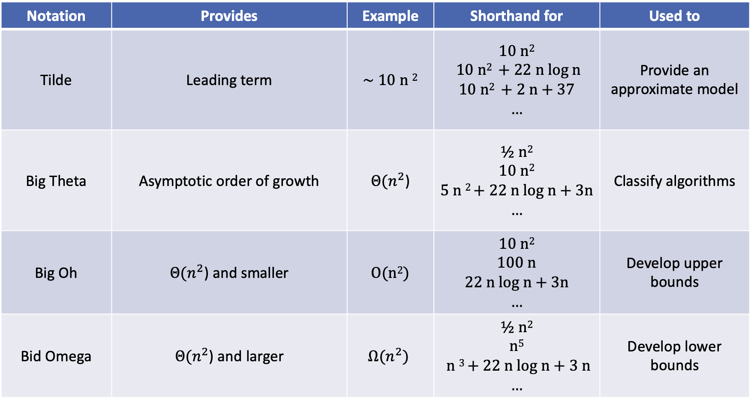
Notation | Provides | Example | Shorthand for | Used to
Tilde | Leading term | ~ 10 n ² | 10 n² 10 n² + 22 n log n 10 n² + 2 n + 37 … | Provide an approximate model
Big Theta | Asymptotic order of growth | $Θ(n^{2}$) | ½ n² 10 n² 5 n ² + 22 n log n + 3n … | Classify algorithms
Big Oh | $Θ(n^{2}$) and smaller | O(n²) | 10 n² 100 n 22 n log n + 3n … | Develop upper bounds
Bid Omega | $Θ(n^{2}$) and larger | $$Ω(n^{2})$$ | ½ n² n⁵ n ³ + 22 n log n + 3 n … | Develop lower bounds

